Slide 1
Welcome to Mrs. Johnston’s room!
2018-19 School Year

Slide 2
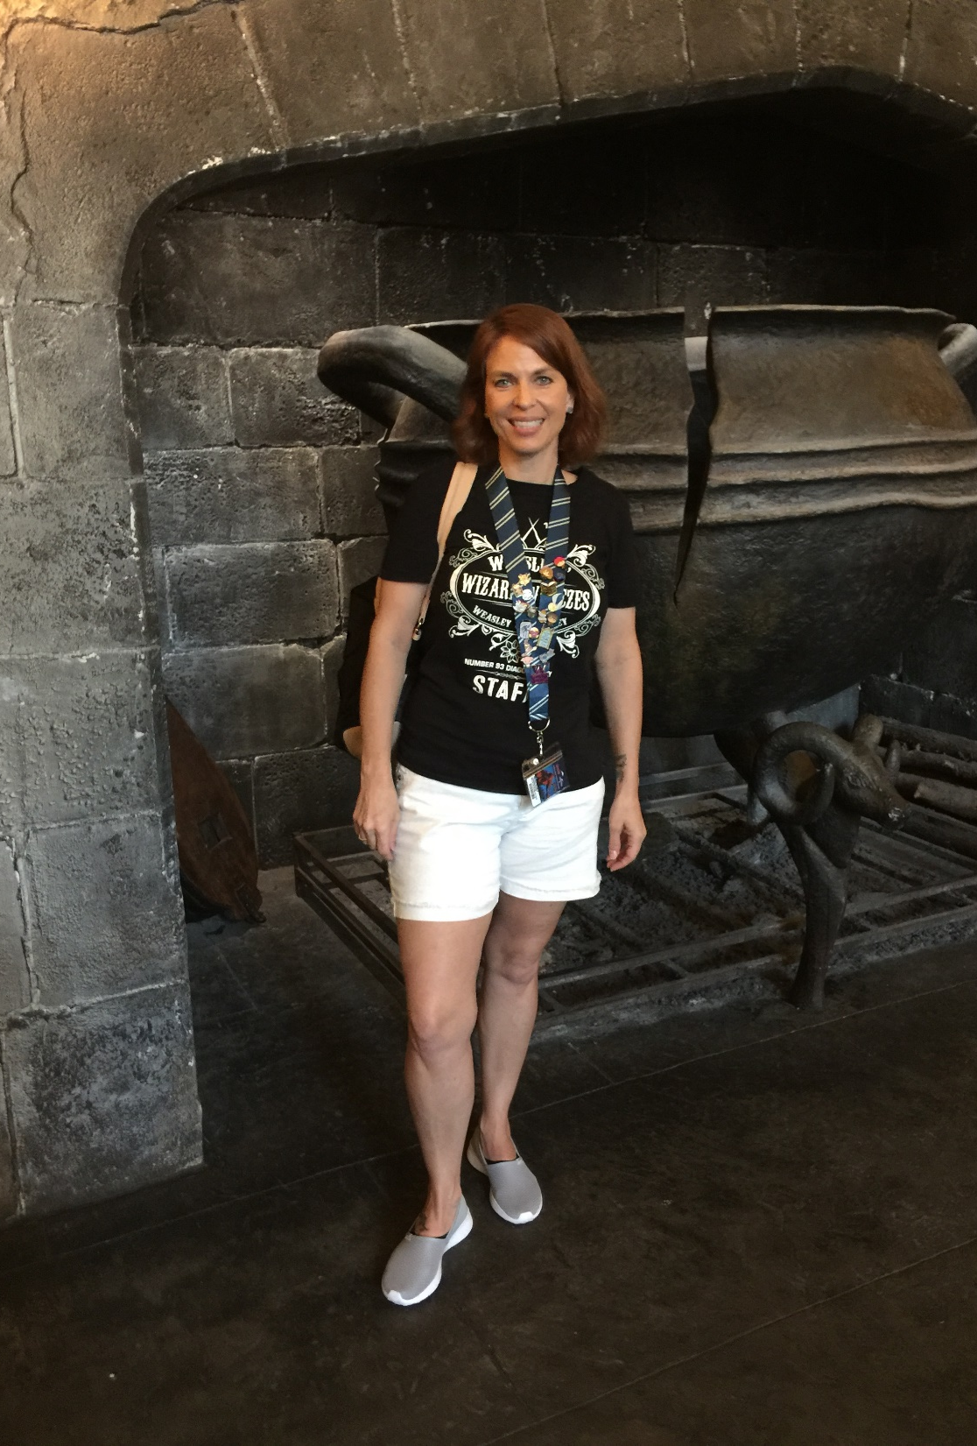
Agenda/Topics to Be Covered
Supplies
Tutorials
Grading
Books
Late Work Policy
Contact Information
Parent Portal

Slide 3
Supplies
All students will need:
A folder with pockets and brads
Pens (blue or black)
Notebook paper
Notecards
Colored pens (for annotation)

Slide 4
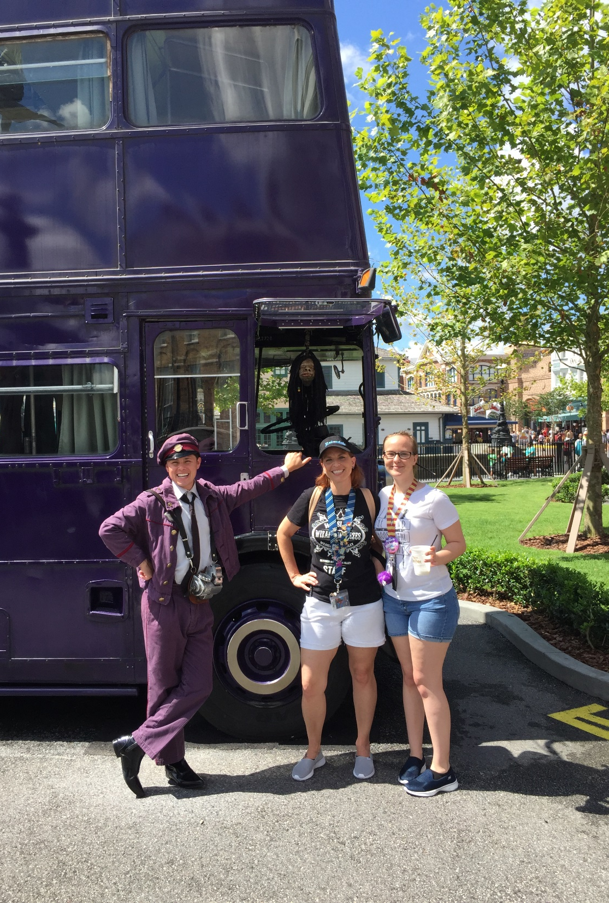
Tutorials
Students may come to tutorials any morning from 7:45-8:20, except for Thursdays when I am on duty. Students may come in to:
Get help with an assignment
Take a test
Read
Get absent work
Turn in late work
Students who do not need to accomplish these things should remain in the gym.
When I am on duty, they can still bring me things to turn and ask me questions.

Slide 5
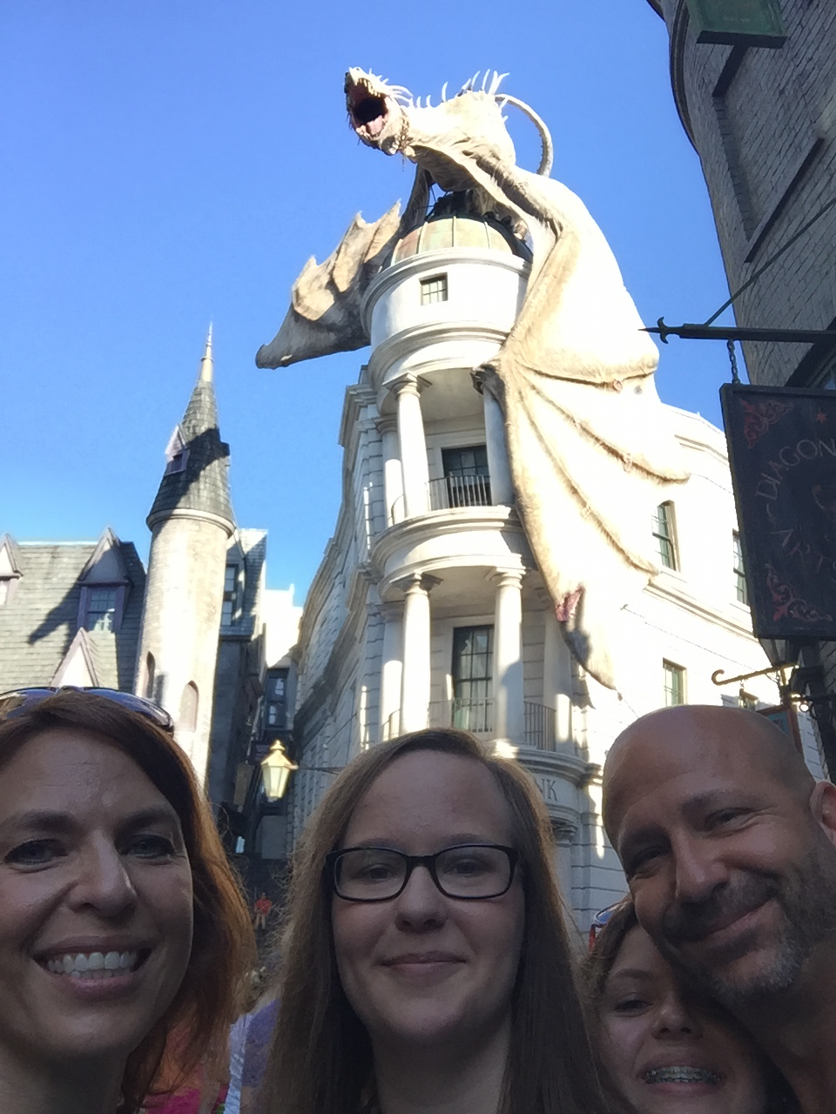
Grading
Objective Measures= 40%: This is not necessarily only work completed in class. These assignments are formative, and not summative.
Summative= 40%: This could be a test, a quiz, a major project, etc., anything that is a summative assessment.
Practice= 10%: assignments will be mostly practice, study materials, BlendSpace explorations, and reading.
Nine Weeks Exam= 10%

Slide 6
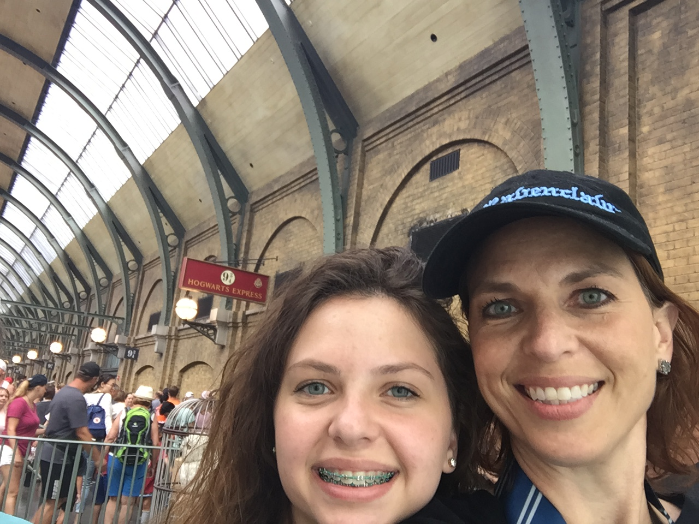
Late Work Policy
Because we are on an A/B schedule, this policy goes by DAYS, not class periods.
1 day late- 10 points off
2 days late- 50 points off
3 days late- no credit given/ zero
When a student is absent, it is their responsibility to get their missed work. It is best for them to try and see the teacher the next day, and not wait until they have their class again. This helps them not get too far behind.

Slide 7
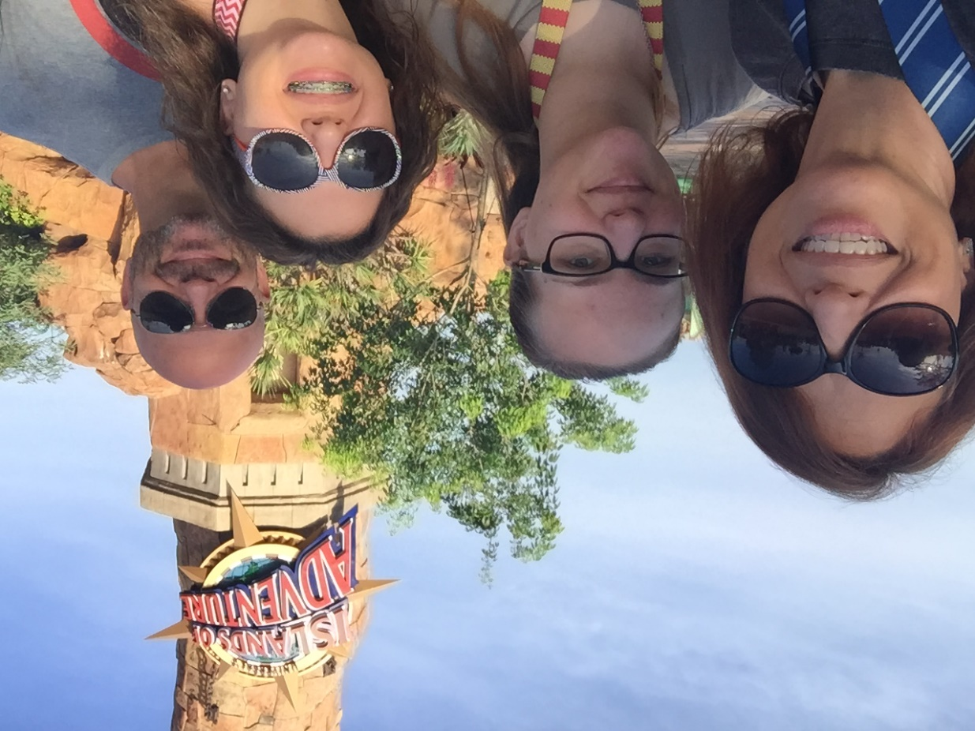
Books Covered
8th Grade
9th Grade
Excerpts from The Odyssey
To Kill a Mockingbird
Night
Romeo and Juliet
The Crucible
Of Mice and Men
The Glass Castle
Gothic novel study

Slide 8
Contact Information
Email- kjohnston@acaedu.net
Website- acajohnstonela.weebly.com
Your student will receive the sign up information for Remind in class tomorrow, and the sign up codes are listed on my website.
Please look over the letters and syllabus that come home the first day, sign the acknowledgement sheet, and have your student return it to me as soon as possible.

Slide 9
Parent Portal
It is extremely important that you are able to access your student’s grades through Parent Portal.
If you are unable to do so, please contact Mrs. Murphree at amurphree@acaedu.net.
Knowing your student’s academic status is vital, so please make sure you are able to check their grades.

