Slide 1
Literature Circle Book Choices
For 8th grade- Mrs. Johnston’s Classes
2020
Please read the synopsis for each book selected for your class and choose the top 3 that you would like to read. Remember to make sure the book is available to your class.

Slide 2
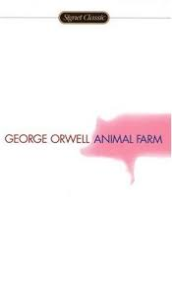
“All animals are equal, but some animals are more equal than others.” A farm is taken over by its overworked, mistreated animals. With flaming idealism and stirring slogans, they set out to create a paradise of progress, justice, and equality. Thus the stage is set for one of the most telling satiric fables ever penned—a razor-edged fairy tale for grown-ups that records the evolution from revolution against tyranny to a totalitarianism just as terrible. When Animal Farm was first published, Stalinist Russia was seen as its target. Today it is devastatingly clear that wherever and whenever freedom is attacked, under whatever banner, the cutting clarity and savage comedy of George Orwell’s masterpiece have a meaning and message still ferociously fresh.
Available in all classes.

Slide 3
At the dawn of the next world war, a plane crashes on an uncharted island, stranding a group of schoolboys. At first, with no adult supervision, their freedom is something to celebrate. This far from civilization they can do anything they want. Anything. But as order collapses, as strange howls echo in the night, as terror begins its reign, the hope of adventure seems as far removed from reality as the hope of being rescued.
Available in all classes.

Slide 4
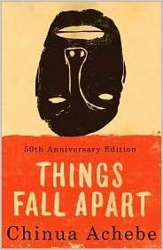
Things Fall Apart is the first of three novels in Chinua Achebe's critically acclaimed African Trilogy. It is a classic narrative about Africa's cataclysmic encounter with Europe as it establishes a colonial presence on the continent. Told through the fictional experiences of Okonkwo, a wealthy and fearless Igbo warrior of Umuofia in the late 1800s, Things Fall Apart explores one man's futile resistance to the devaluing of his Igbo traditions by British political and religious forces and his despair as his community capitulates to the powerful new order. With more than 20 million copies sold and translated into fifty-seven languages, Things Fall Apart provides one of the most illuminating and permanent monuments to African experience. Achebe does not only capture life in a pre-colonial African village, he conveys the tragedy of the loss of that world while broadening our understanding of our contemporary realities.
Available in all classes.

Slide 5
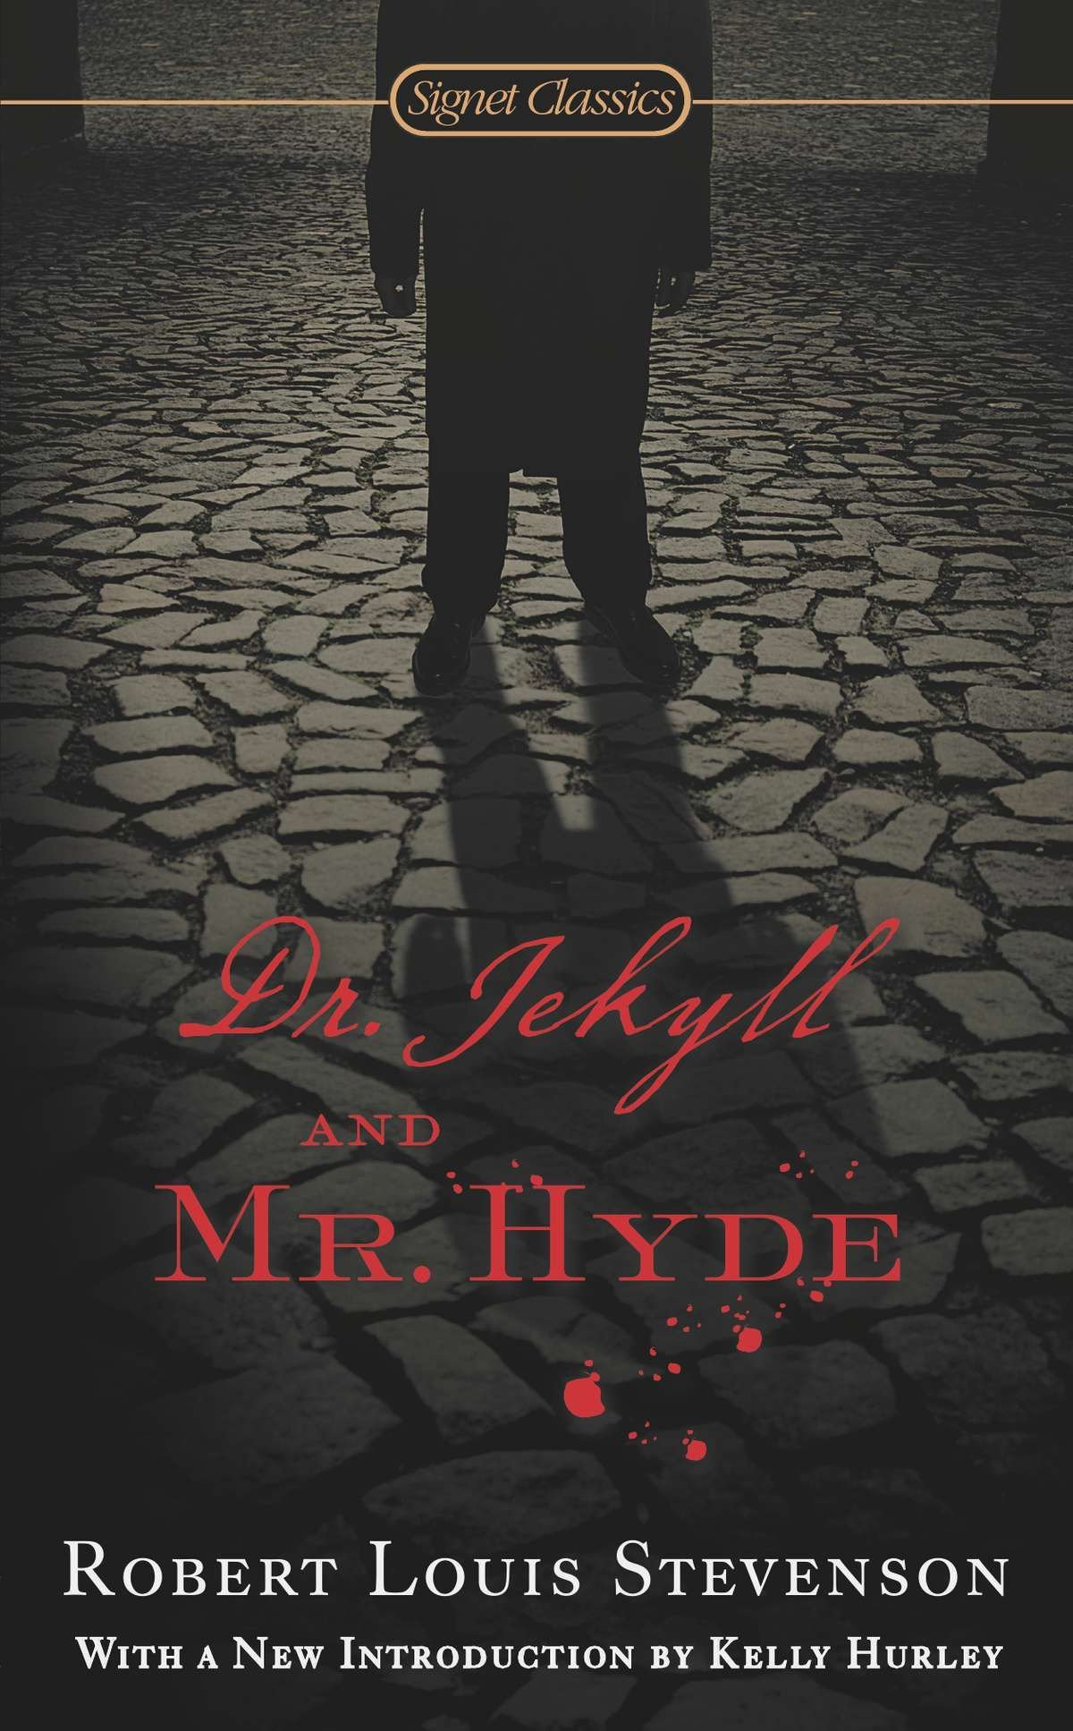
Strange Case of Dr Jekyll and Mr. Hyde is the original title of a novella written by the Scottish author Robert Louis Stevenson that was first published in 1886. The work is commonly known today as The Strange Case of Dr. Jekyll and Mr. Hyde, Dr. Jekyll and Mr. Hyde, or simply Jekyll & Hyde. It is about a London lawyer named Gabriel John Utterson who investigates strange occurrences between his old friend, Dr. Henry Jekyll, and the evil Edward Hyde. The work is commonly associated with the rare mental condition often spuriously called "split personality", referred to in psychiatry as dissociative identity disorder, where within the same body there exists more than one distinct personality. In this case, there are two personalities within Dr. Jekyll, one apparently good and the other evil. The novella's impact is such that it has become a part of the language, with the very phrase "Jekyll and Hyde" coming to mean a person who is vastly different in moral character from one situation to the next.
Available in all classes.

Slide 6
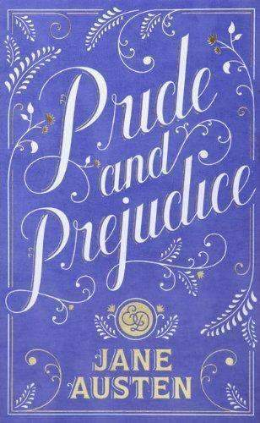
One of the most universally loved and admired English novels, Pride and Prejudice was penned as a popular entertainment. But the consummate artistry of Jane Austen (1775–1817) transformed this effervescent tale of rural romance into a witty, shrewdly observed satire of English country life that is now regarded as one of the principal treasures of English language.
In a remote Hertfordshire village, far off the good coach roads of George III's England, a country squire of no great means must marry off his five vivacious daughters. At the heart of this all-consuming enterprise are his headstrong second daughter Elizabeth Bennet and her aristocratic suitor Fitzwilliam Darcy — two lovers whose pride must be humbled and prejudices dissolved before the novel can come to its splendid conclusion.
Available for 1st and 5th periods.

Slide 7
Set in Mississippi at the height of the Depression, this is the story of one family's struggle to maintain their integrity, pride, and independence in the face of racism and social injustice. And it is also Cassie's story—Cassie Logan, an independent girl who discovers over the course of an important year why having land of their own is so crucial to the Logan family, even as she learns to draw strength from her own sense of dignity and self-respect.
Available for 1st period.

Slide 8
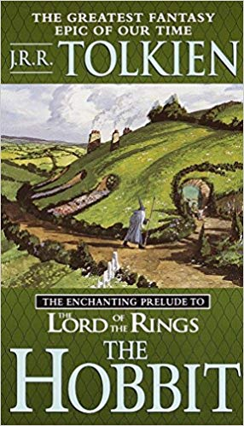
Like every other hobbit, Bilbo Baggins likes nothing better than a quiet evening in his snug hole in the ground, dining on a sumptuous dinner in front of a fire. But when a wandering wizard captivates him with tales of the unknown, Bilbo becomes restless. Soon he joins the wizard's band of homeless dwarves in search of giant spiders, savage wolves, and other dangers. Bilbo quickly tires of the quest for adventure and longs for the security of his familiar home. But before he can return to his life of comfort, he must face the greatest threat of all - a treasure-troving dragon named Smaug.
In this fantasy classic, master storyteller J.R.R. Tolkien creates a bewitching world filled with delightful creatures and thrilling dangers.
Available for 1st period.

Slide 9
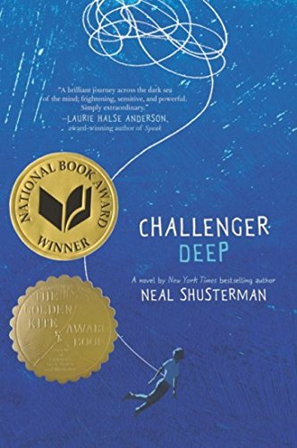
Caden Bosch is on a ship that's headed for the deepest point on Earth: Challenger Deep, the southern part of the Marianas Trench.
Caden Bosch is a brilliant high school student whose friends are starting to notice his odd behavior.
Caden Bosch is designated the ship's artist in residence, to document the journey with images.
Caden Bosch pretends to join the school track team but spends his days walking for miles, absorbed by the thoughts in his head.
Caden Bosch is split between his allegiance to the captain and the allure of mutiny.
Caden Bosch is torn.
A captivating and powerful novel that lingers long beyond the last second, Challenger Deep is a heartfelt tour de force by one of today's most admired writers for teens.
Available for 1st and 5th periods.

Slide 10
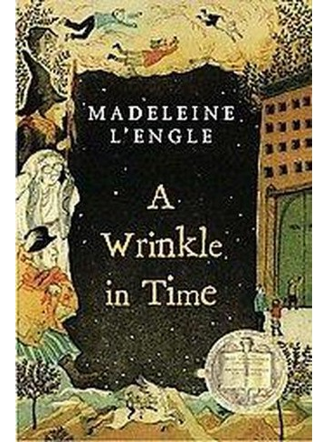
Meg Murry, her little brother Charles Wallace, and their mother are having a midnight snack on a dark and stormy night when an unearthly stranger appears at their door. He claims to have been blown off course and goes on to tell them that there is such a thing as a "tesseract", which, if you didn't know, is a wrinkle in time. Meg's father had been experimenting with time travel when he suddenly disappeared. Will Meg, Charles Wallace, and their friend Calvin outwit the forces of evil as they search through space for their father?
In 1962, Madeleine L'Engle debuted her novel A Wrinkle in Time, which would go on to win the 1963 Newbery Medal. Bridging science and fantasy, darkness and light, fear and friendship, the story became a classic of children's literature and is beloved around the world.
Available for 3rd period.

Slide 11
Although the mission school bans all that is Navajo, Ned secretly clings to his native language and culture. Proudly joining the U.S. Marines in 1943, he becomes a top-secret Navajo Code Talker. During bloody battles for Japanese islands, Ned and his brave band of code-talking brothers save thousands of lives using Navajo encryption the enemy never cracks.
Available for 3rd period.

Slide 12
Tennyson: Don't get me started on the Bruiser. He was voted "Most Likely to Get the Death Penalty" by the entire school. He's the kid no one knows, no one talks to, and everyone hears disturbing rumors about. So why is my sister, Brontë, dating him? One of these days she's going to take in the wrong stray dog, and it's not going to end well.
Bronte: My brother has no right to talk about Brewster that way - no right to threaten him. There's a reason why Brewster can't have friends - why he can't care about too many people. Because when he cares about you, things start to happen. Impossible things that can't be explained. I know, because they're happening to me.
Award-winning author Neal Shusterman has crafted a chilling and unforgettable novel about the power of unconditional friendship, the complex gear workings of a family, and the sacrifices we endure for the people we love.
Available for 3rd and 8th periods.

Slide 13
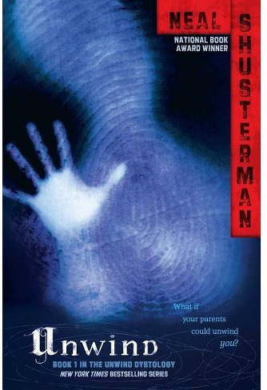
In America after the Second Civil War, the Pro-Choice and Pro-Life armies came to an agreement: The Bill of Life states that human life may not be touched from the moment of conception until a child reaches the age of thirteen. Between the ages of thirteen and eighteen, however, a parent may choose to retroactively get rid of a child through a process called "unwinding." Unwinding ensures that the child's life doesn’t “technically” end by transplanting all the organs in the child's body to various recipients. Now a common and accepted practice in society, troublesome or unwanted teens are able to easily be unwound. With breathtaking suspense, this book follows three teens who all become runaway Unwinds: Connor, a rebel whose parents have ordered his unwinding; Risa, a ward of the state who is to be unwound due to cost-cutting; and Lev, his parents’ tenth child whose unwinding has been planned since birth as a religious tithing. As their paths intersect and lives hang in the balance, Shusterman examines complex moral issues that will keep readers turning the pages until the very end.
Available for 3rd and 5th periods.

Slide 14
A mysterious island.
An abandoned orphanage.
A strange collection of very curious photographs.
It all waits to be discovered in Miss Peregrine's Home for Peculiar Children, an unforgettable novel. As our story opens, a horrific family tragedy sets 16-year-old Jacob journeying to a remote island off the coast of Wales, where he discovers the crumbling ruins of Miss Peregrine's Home for Peculiar Children. As Jacob explores its abandoned bedrooms and hallways, it becomes clear that the children were more than just peculiar. They may have been dangerous. They may have been quarantined on a deserted island for good reason. And somehow - impossible though it seems - they may still be alive.
A spine-tingling fantasy, Miss Peregrine's Home for Peculiar Children will delight adults, teens, and anyone who relishes an adventure in the shadows.
Available for 4th and 8th periods.

Slide 15
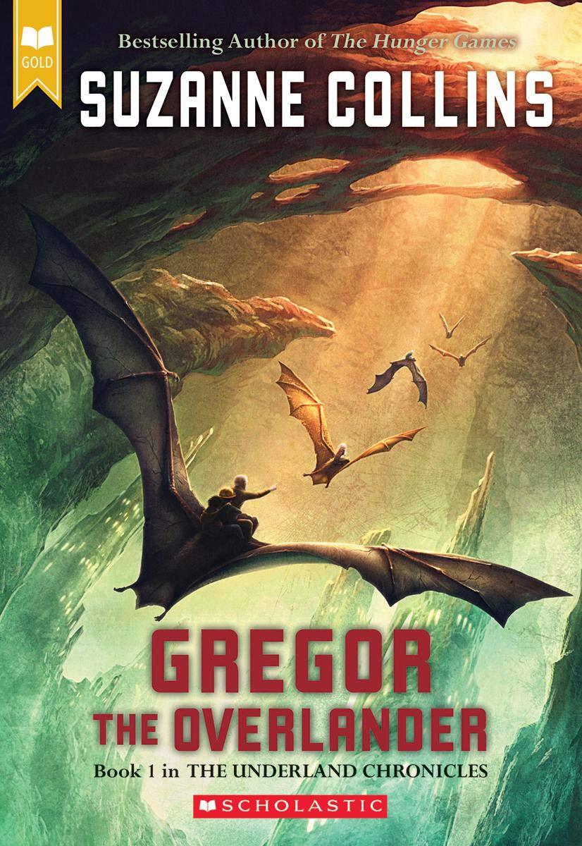
Rich in suspense and brimming with adventure, the New York Times-bestselling Underland Chronicles unfold the fate of the Underland and the great warrior, Gregor. Suzanne Collins is also the author of the bestselling Hunger Games trilogy.
When Gregor falls through a grate in the laundry room of his apartment building, he hurtles into the dark Underland, where spiders, rats, and cockroaches coexist uneasily with humans. This world is on the brink of war, and Gregor's arrival is no accident. A prophecy foretells that Gregor has a role to play in the Underland's uncertain future. Gregor wants no part of it, until he realizes it's the only way to solve the mystery of his father's disappearance. Reluctantly, Gregor embarks on a dangerous adventure that will change both him and the Underland forever.
Available for 4th period.

Slide 16
Sixteen-year-old Blake has always been the responsible one in his dysfunctional family -- the one who drives safely, gets good grades, and looks after his wild younger brother, Quinn. Quinn is his brother's opposite -- a thrill-seeker who's always chasing the next scary rush, no matter what the cost. But Quinn and Blake are in for the surprise of their lives when they're thrust into the world of a bizarre phantom carnival -- and their souls are the price of admission. In order to save his brother, and himself, Blake must survive seven different carnival rides before dawn. Seven rides...it sounds easy. But each ride is full of unexpected dangers, because each ride is a reflection of one of Blake's deepest fears. And the last ride is the worst one of all. Because that's the one that confronts Blake with a terrifying secret from his past -- a secret he's been running from for years. Full of roller-coaster twists and turns, Neal Shusterman's latest page-turner is an Orpheus-like adventure into one boy's psyche.
Available for 4th period.

Slide 17
The drought - or the Tap-Out, as everyone calls it - has been going on for a while now. Everyone's lives have become an endless list of don'ts: don't water the lawn, don't fill up your pool, don't take long showers.
Until the taps run dry.
Suddenly, Alyssa's quiet suburban street spirals into a warzone of desperation; neighbors and families turned against each other on the hunt for water. And when her parents don't return and her life - and the life of her brother - is threatened, Alyssa has to make impossible choices if she's going to survive.
Available for 4th and 8th periods.

Slide 18
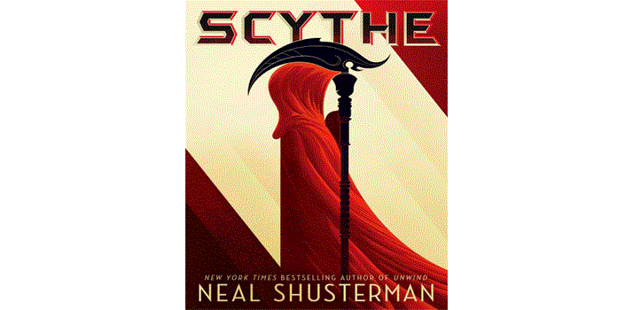
A world with no hunger, no disease, no war, no misery: Humanity has conquered all those things and has even conquered death. Now Scythes are the only ones who can end life - and they are commanded to do so in order to keep the size of the population under control.
Citra and Rowan are chosen to apprentice to a scythe - a role that neither wants. These teens must master the "art" of taking life, knowing that the consequence of failure could mean losing their own.
Scythe is the first novel of a thrilling series by National Book Award-winning author Neal Shusterman in which Citra and Rowan learn that a perfect world comes only with a heavy price.
Available for 4th and 7th periods.

Slide 19
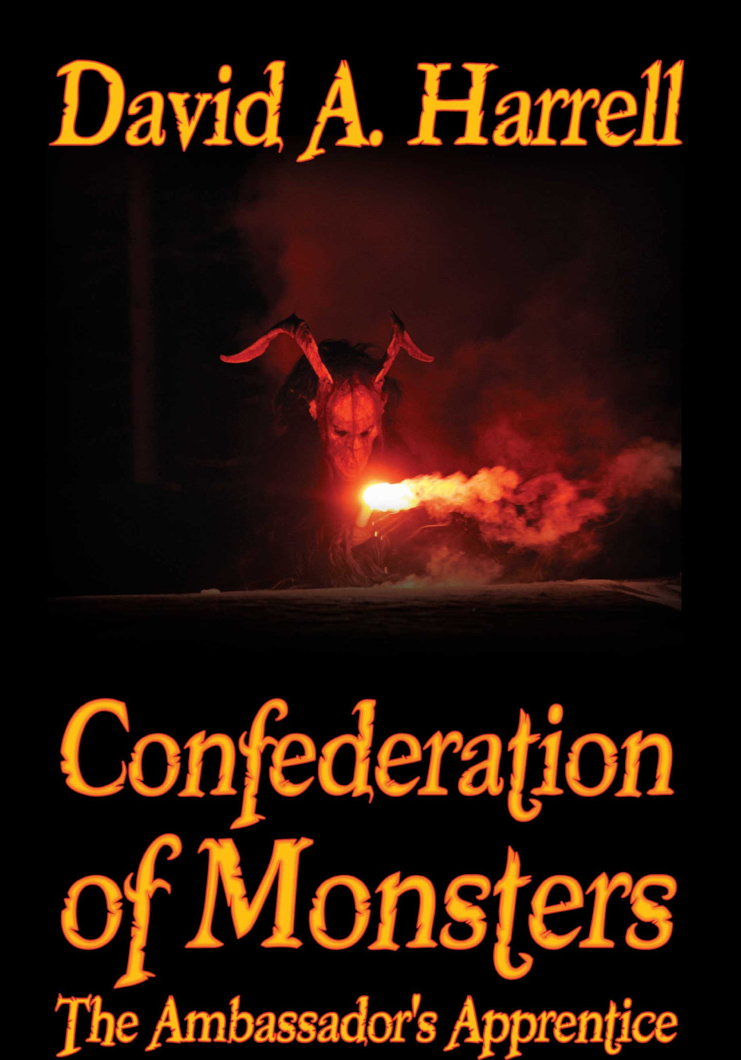
Have you ever wondered what it would be like if the monsters and creatures your parents told you about when you were little were actually real?
What if those tales were not imagined, but actual stories of an ancestral species that had been in North America long before the Europeans settled this land?
His middle school classmates had always considered Baibin Artweiller an outcast, and he preferred it that way.
After an art project assignment unwillingly placed Baibin, Sam and Rachel in the same group, they were forced to figure out how to get along and work together. When Baibin received word that his grandfather (Ambassador to the Monsters) had been kidnapped, the trio were thrust in a world where the Bogeyman was set on world domination and the "Monster Under the Bed" became their guide.
Together, the three teenagers embark on a hair-raising adventure to figure out who kidnapped Baibin's grandfather, what are their plans and how they can stop them. Along the way, they run into wonderful creatures as Rose Garland the Wise, Queen of the Botanicals and Hartreal the Historian, Troll Under the Bridge. Eventually, their voyage takes them underground for the final battle against Maltroph (the Bogeyman) and his army.
Available for 5th and 7th periods.

Slide 20
When Death has a story to tell, you listen. It is 1939. Nazi Germany. The country is holding its breath. Death has never been busier, and will become busier still. Liesel Meminger is a foster girl living outside of Munich, who scratches out a meager existence for herself by stealing when she encounters something she can't resist - books. With the help of her accordion-playing foster father, she learns to read and shares her stolen books with her neighbors during bombing raids as well as with the Jewish man hidden in her basement.
In superbly crafted writing that burns with intensity, award-winning author Markus Zusak, author of I Am the Messenger, has given us one of the most enduring stories of our time.
Available for 5th period.

Slide 21
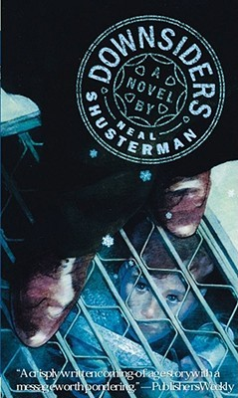
Beneath the sewer grates and manholes of the city lies a strange and secret world called the Downside. Every Downsider knows that it's forbidden to go Topside, and most fear a collision of the two worlds. But fourteen-year-old Talon is curious about what goes on above ground, and one day he ventures out in search of medicine for his ailing sister. There he meets Lindsay, who is as curious about Talon's world as he is about hers. When Lindsay visits the Downside for the first time, she marvels at the spirit of the Downsiders, and the way they create works of art from topside "trash," like old subway tokens and forgotten earrings. As awed as she is by the Downside, however, she also questions its origins, and when she finds out that this fantastic world is not all it appears to be, she is determined to tell Talon the truth. Then a construction accident threatens to crush Talon's world, and his loyalty is put to the test. Can the truth save the Downside, or will it destroy an entire civilization? Neal Shusterman takes readers on an amazing journey into a place that's only a few steps away, yet beyond their wildest dreams.
Available for 7th period.

Slide 22
In this thought-provoking examination of freedom, patriotism, and respect, ninth grader Philip Malloy is kept from joining the track team by his failing grades in English class. Convinced that the teacher just doesn't like him, Philip concocts a plan to get transferred out of her class. Breaking the school's policy of silence during the national anthem, he hums along, and ends up in a crisis at the center of the nation's attention.
Available for 7th and 8th periods.

