Slide 1
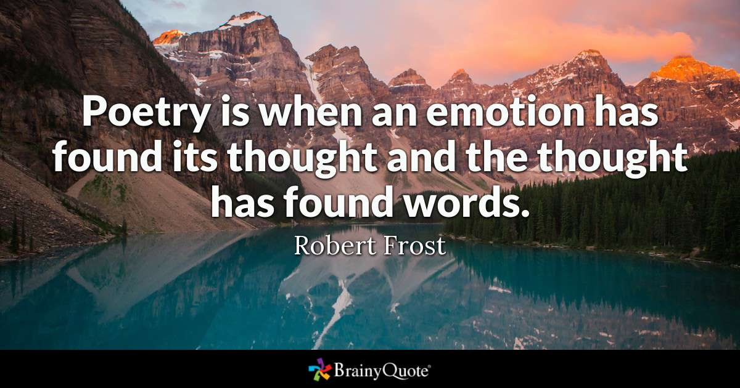
Potent Quotables
February 19 & 20
Read the quote. Write a response to it. What does it mean to you? Do you think it’s a true statement? Why or why not? Fill the space on your Do Now paper.

Slide 2
Academic Vocabulary
February 21 & 24
Copy the terms and definitions onto your Do Now paper.

Slide 3
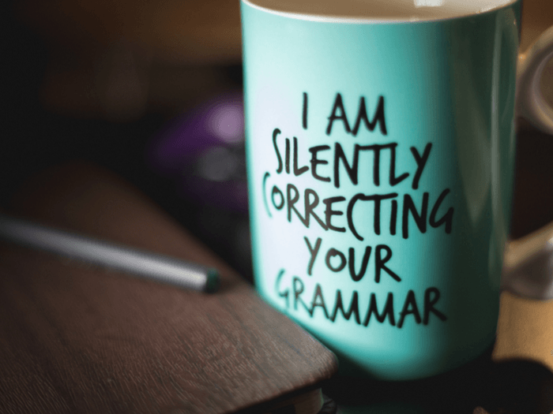
Grammar Guru
February 25 & 26
Correct each of the following to create complete or correct sentences.
After he went to the store
I went to the school dance, there was no one there.
My mother decided to tell me that she wants me to do chores right before I was leaving so now I have to be late to my lesson.

Slide 4
Creative Writing
February 27 & 28
Write a short summary of a book you’d like to read.

Slide 5
Critical Thinking
March 4 & 5
How does poetry make a difference in the world? Write your answer on your Do Now paper, and make sure you fill the space.

