Slide 1
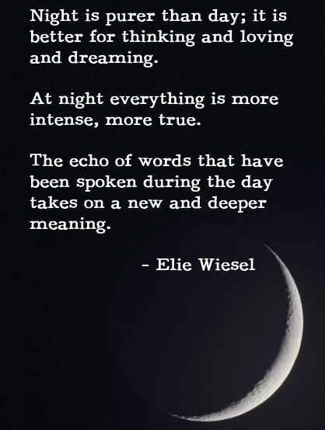
Potent Quotables
January 29 & 30
Read the quote.
Write a response to it. What does it mean to you?
Do you think it’s an accurate
statement?
Why or why not?
Fill the space on your Do Now paper.

Slide 2
Academic Vocabulary
January 31 & February 3
Copy the term, definition,
and examples onto your
Do Now paper.

Slide 3
Grammar Guru
February 4 & 5
What are the 4 types of sentences? What are the 4 types of sentence structures?
Write each list of 4 on your Do Now paper.

Slide 4
Creative Writing
February 6 & 10
Write a 4 line poem with an ABAB rhyme scheme about Night.

Slide 5
Critical Thinking
February 11 & 12
Explain how you can take your understanding of song lyrics and use it to better understand poetry. Write your answer on your Do Now paper, and make sure you fill the space.

