Slide 1
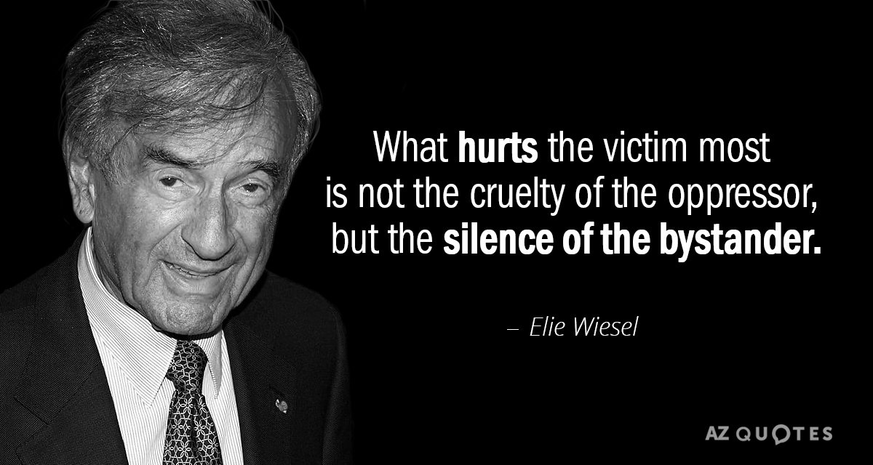
Potent Quotables
November 21 & 22
Read the quote.
Write a response to it. What does it mean? Do you think it’s an accurate statement? Why or why not?
Fill the space on your Do Now paper.

Slide 2
Academic Vocabulary
December 2 & 3
Copy the terms and definitions onto your Do Now paper.
Memoir vs. Autobiography
Memoir: a record of events written by a person having intimate knowledge of them and based on personal observation.
Autobiography: a history of a person's life written or told by that person
Difference: An autobiography focuses on the chronology of the writer's entire life while a memoir covers one specific aspect of the writer's life.

Slide 3
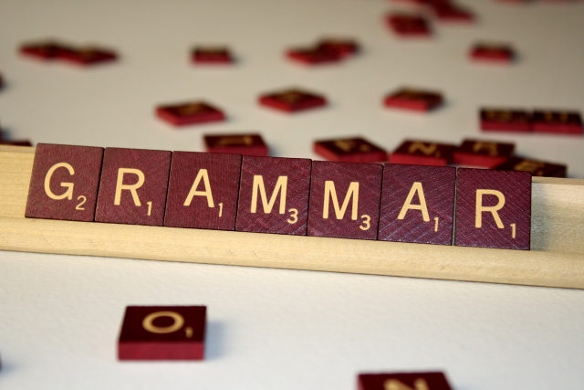
Grammar Guru
December 4 & 5
Write sentences that include an example of each of the following types of phrases. You may write one sentence using all three, a separate sentence for each, etc. as long as you use each one.
-an adverbial phrase
- An adjectival phrase

Slide 4
Creative Writing
December 6 & 9
Write a detailed, creative summary of an event in your life.
Fill the space on your Do Now paper.

Slide 5
Critical Thinking
December 10 & 11
What theme do you think is most prevalent in Night so far and why? Write your answer on your Do Now paper, and make sure you fill the space.

