Slide 1
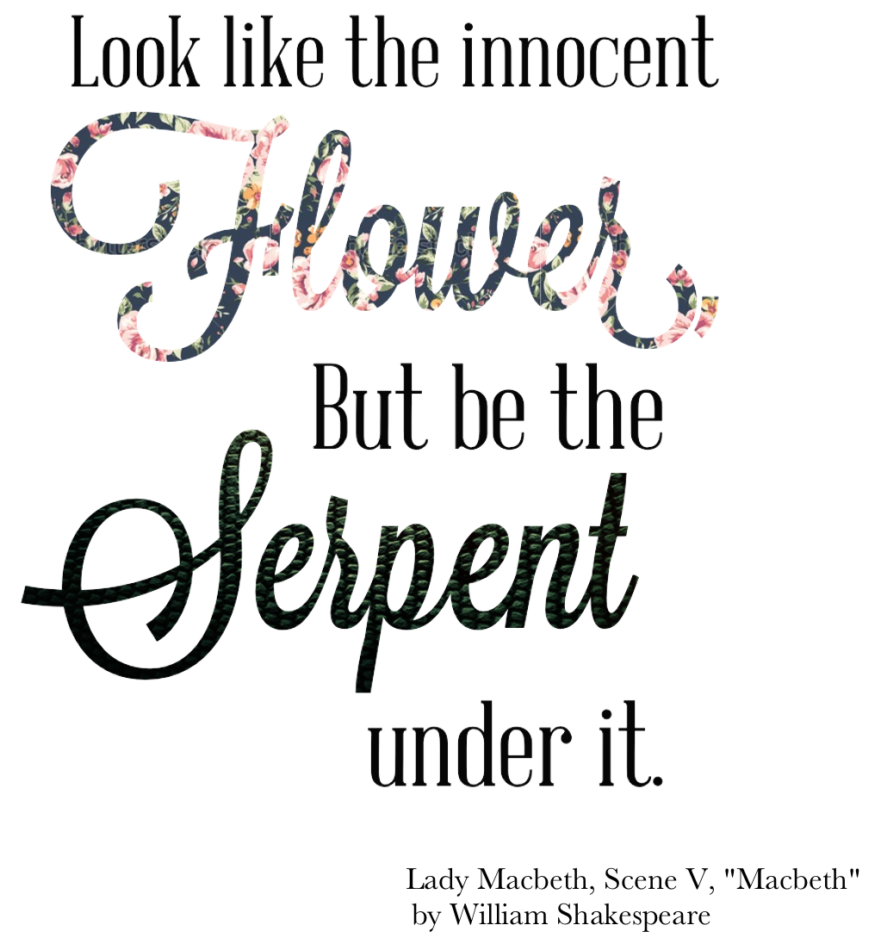
Potent Quotables
September 3 & 4
Read the quote to the left.
Write a response to it. In what context would a person say this? Is it good advice? Why or why not?
Fill the space on your Do Now paper.

Slide 2
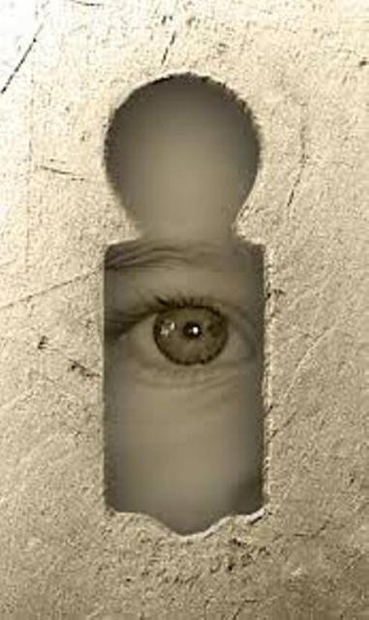
Write down the term, definition, and example on your Do Now paper.
Paraclausithyron
A Greek motif in which someone sings outside their lover’s door, begging to be let in.
Despite being an ancient motif, it’s still found in modern pop culture; it’s the man standing on a woman’s lawn playing a guitar or holding a boombox over his head while she watches through the window.
Academic Vocabulary
September 9 & 10

Slide 3
Grammar Guru
September 11 & 12
1. Write a sentence with a compound subject and an action verb.
2. Write a sentence with a proper noun and a linking verb.
3. Write a sentence with a compound predicate.

Slide 4
Creative Writing
September 13 & 16
Tweet a summary of your favorite story. Old school tweets! So you only get 140 characters. You also need to add two or three #s that pertain to the story to the end (the #s do not add to the character count).

Slide 5
Critical Thinking
September 17 & 18
How would you explain inferencing to a classmate that didn’t understand how to do it?
Fill the space on your Do Now paper with your explanation.

