Slide 1
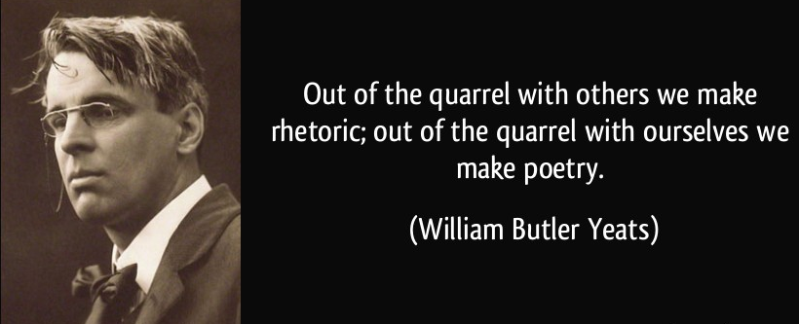
Potent Quotables
November 5 & 6
Read the quote.
Write a response to it. What does it mean? Do you think it’s an accurate statement? Why or why not?
Fill the space on your Do Now paper.

Slide 2
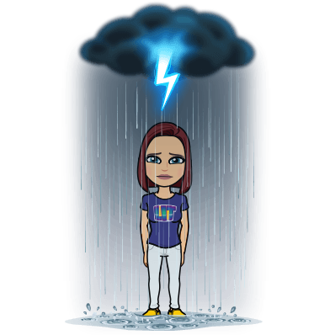
Academic Vocabulary
November 7 & 8
Copy the term and definition onto your Do Now paper.
Symbolism: the art or practice of using symbols especially by investing things with a symbolic meaning or by expressing the invisible or intangible by means of visible or sensuous representations

Slide 3
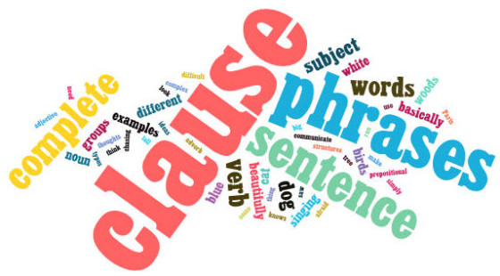
Grammar Guru
November 11 & 12
Write sentences that include an example of each of the following types of phrases. You may write one sentence using all three, a separate sentence for each, etc. as long as you use each one.
-An appositive
-A prepositional phrase
-An infinitive phrase

Slide 4
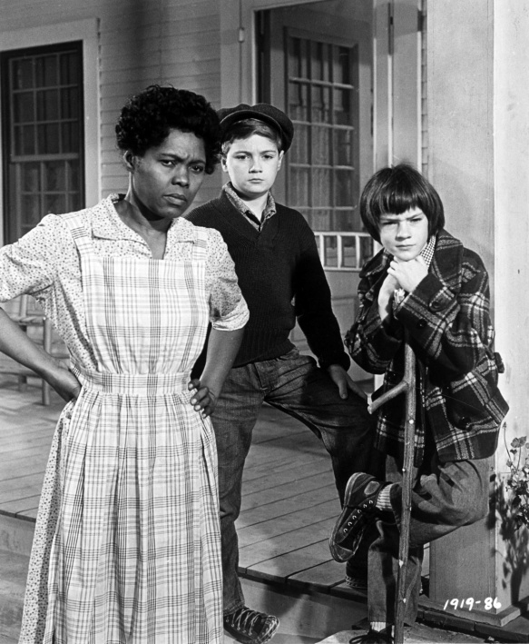
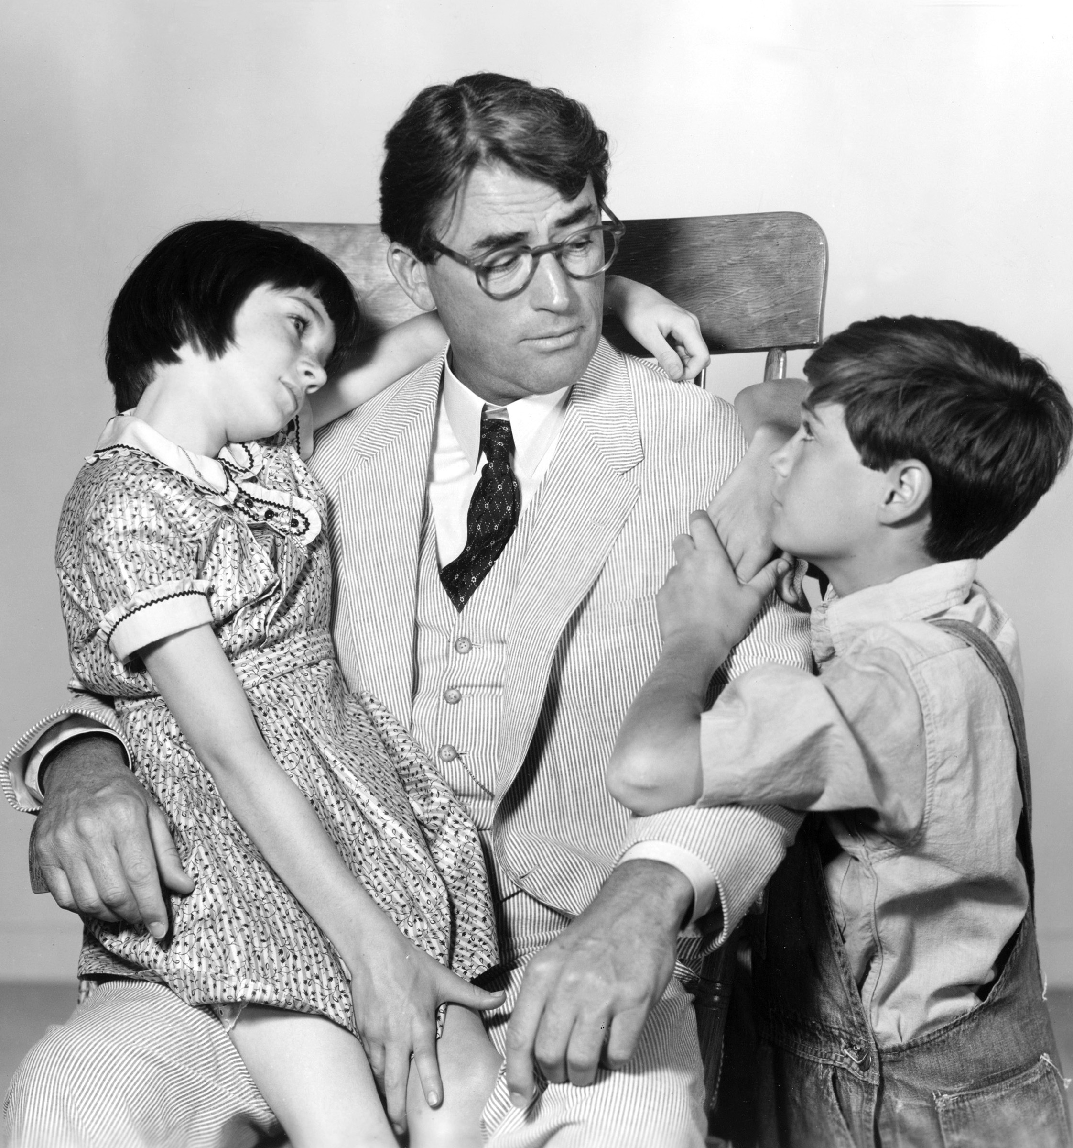
Creative Writing
November 13 & 14
Write a detailed, creative description of your favorite character from To Kill a Mockingbird.
Fill the space on your Do Now paper.

Slide 5
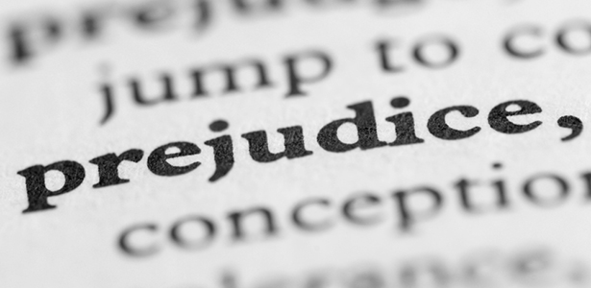
Critical Thinking
November 19 & 20
Now that we’ve read some of the novel, what is your definition of prejudice? Write exactly what that word means to you on your Do Now paper, and make sure you fill the space.

