Slide 1
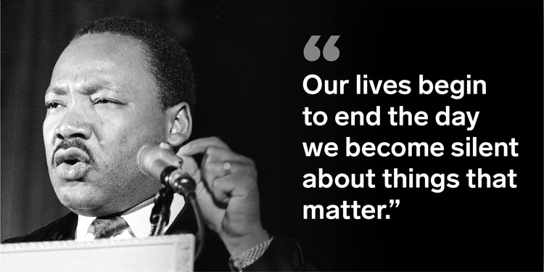
Potent Quotable
October 22 & 23
Read the quote to the left.
Write a response to it. What does it mean? Who could benefit from hearing this statement and why?
Fill the space on your Do Now paper.

Slide 2
Academic Vocabulary
October 24 & 25
Copy the term, definition, and examples onto your Do Now paper.
Bildungsroman- a type of novel concerned with the education, development, and maturing of a young protagonist
Examples:

Slide 3
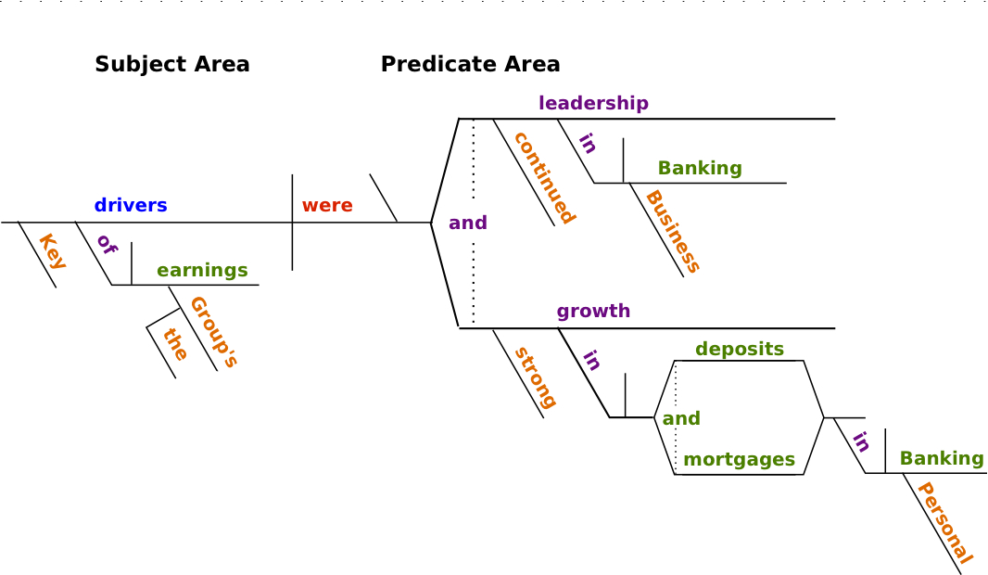
Grammar Guru
October 28 & 29
Write three sentences. You must include each of the following once: direct object, indirect object, predicate nominative, and predicate adjective

Slide 4
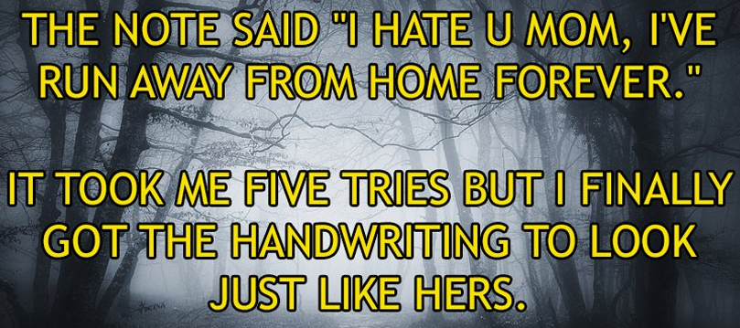
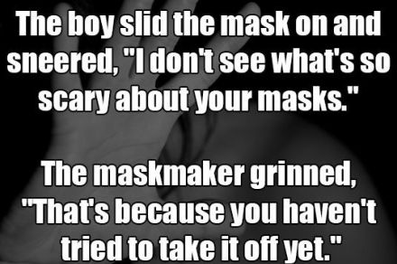
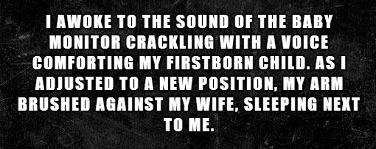
Creative Writing
October 30 & 31
Write a 2-sentence horror story.

Slide 5
Critical Thinking
November 1 & 4
What types of situations do you find yourself in that require persuasion? Make sure you fill the space on your Do Now paper.

